Slide 1
Econ 100 Principles of Economics
Lecture 21
May 20

Slide 2
Unemployment

Slide 3

This is Michael Dixon, an experienced software test engineer.
As of June 2012, he hasn't had a job since September 2011, but he's definitely not relaxing at home.
Living at a friend's house without paying rent, he spends all day searching online for job opportunities and more short-term ways to make money, fearing that if he stops to watch TV, he'll miss something.
"It's kind of like a feeling of 'I can't believe this is happening to me,' and a sense of hopelessness," said Dixon, a 38-year-old Seattle resident. "You really, really, truly start to question who you are."

Slide 4
Describing Unemployment
Three Basic Questions`
How does government measure the economy’s rate of unemployment?
What problems arise in interpreting the unemployment data?
How long are the unemployed typically without work?

Slide 5
Labor Force Statistics
Produced by Türkiye İstatistik Kurumu (TÜİK)
Regular surveys of many households, interviews with “adult population” (15 years or older).
Most current (March 15 2013 Bulletin)
Hanehalkı İşgücü İstatistikleri December 2012: Örnek hanehalklarında yaşayan 15 ve daha yukarı yaştaki toplam 95 bin 578 fert ile görüşülmüştür.)

Slide 6
Labor Force Statistics
The population is divided into 3 groups:
employed: paid employees, self-employed, and unpaid workers in a family business
unemployed: people not working who have looked for work during previous 3 months. (4 weeks in Europe and US)
not in the labor force: everyone else
The labor force is 1 + 2: It is the sum of the employed and unemployed workers (job searchers) .

Slide 7
TUIK definitions employment

Slide 8
LABOR FORCE
LABOR FORCE: The non-institutional working age population included in the employed and unemployed group is the labor force.
Employed: Persons who are engaged in economic activity for at least one hour during the reference period as a paid, salaried, daily wage, self-employed, employer or unpaid family worker.
What is “non-institutional working age ”?
What is “reference period”?

Slide 9
NON-INSTITUTIONAL POPULATION: Population excluding residents in university dormitories, orphanages (orphanages), nursing homes, private hospitals, prisons, barracks, etc.
NON-INSTITUTIONAL WORKING AGE POPULATION: The population aged 15 and over in the non-institutional population.

Slide 10
Reference period
One week period when the survey period of unemployment is done. Generally the first week of each month .

Slide 11
Employed but not currently at work: Self-employed and employers who are not at work for various reasons during the reference week, although they are still connected, are considered to be employed.
Individuals who are paid and salaried employees and who are not at work during the reference period for various reasons; only if they return to work within 3 months or if they continue to receive at least 50% or more of their salary or wages during their absence from work.

Slide 12
Employed: finally…
Members of producer cooperatives and employees (apprentices, interns, etc.) in return for a certain benefit (income in kind or in cash, social security, travel allowance, pocket money, etc.) in order to increase their professional knowledge are accepted in employment.

Slide 13
Definition of Unemployed
Unemployed: Persons of non-institutional working age who used at least one of the job search channels in the last three months and were able to start work within 2 weeks, among those who were not in employment during the reference period, are included in the unemployed population.
Those who have found a job or started their own business within three months but are waiting to start a job or start work to complete their various deficiencies are also included in the scope of the unemployed population.

Slide 14
Employed Unemployed Not in the labor force
One more time…

Slide 15
Labor Force Statistics
The population is divided into 3 groups:
employed: paid employees, self-employed, and unpaid workers in a family business
unemployed: people not working who have looked for work during previous 3 months. (4 weeks in Europe and US)
not in the labor force: everyone else
The labor force is 1 + 2: It is the sum of the employed and unemployed workers (job searchers) .

Slide 16
Two very important statistics
The unemployment rate
The labor force participation rate

Slide 17
Labor Force Statistics
Unemployment rate (the “u-rate”): % of the labor force that is unemployed
# of unemployed
u-rate
= 100 x
labor force
Labor force participation rate: % of the adult population that is in the labor force
labor force participation rate
labor force
= 100 x
adult population

Slide 18

The breakdown of the adult population in 2012
Employed
(24.8 million)
Labour Force
(27.6 million)
Adult
Population
(55.2 million)
Unemployed (2.8 million)
Not in the labor force
(27.6 million)

Slide 19
Please compute the Unemployment rate (% of the labor force that is unemployed) and the Labor Force Participation Rate: (% of the adult population that is in the labor force) for Turkey 2012.
Employed 24,760,000
Unemployed 2,790,000
Adult population 55,162,000

Slide 20
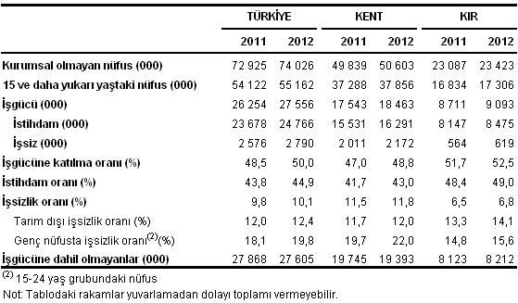
TUIK Household Labor Force Statistics, December 2012 Unemployment rate was 10.1%

Slide 21
⁽¹⁾ The time period in which the months of November, December 2012 and January 2013 are covered is referred to as the middle month, 2012 December.
TUIK bulletin on employment
The number of unemployed people in Turkey increased by 214 thousand people in December (1) period of 2012 compared to the same period of the previous year and reached 2 million 790 thousand people. Unemployment rate, on the other hand, increased by 0.3 points to 10.1%. Non-agricultural unemployment rate increased by 0.4 points to 12.4%, while youth unemployment rate including the 15-24 age group increased by 1.7 points to 19.8%. The number of employed persons increased by 1 million 88 thousand persons in December 2012 compared to the same period of the previous year and reached 24 million 766 thousand persons.
During this period, the number of employees in the agricultural sector increased by 87 thousand people, and the number of employees in non-agricultural sectors increased by 1 million people.

Slide 22
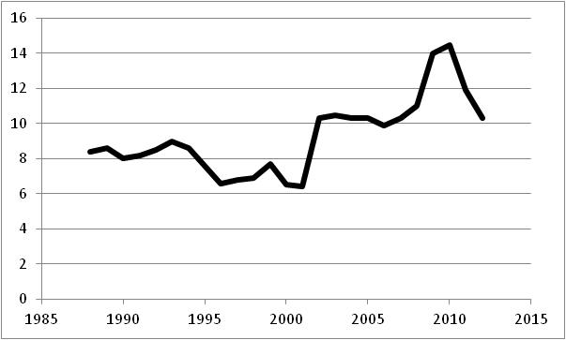
Unemployment in Turkey 1988 – 2012

Slide 23
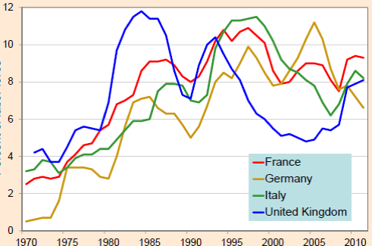
Unemployment in Europe, 1960–2011

Slide 24
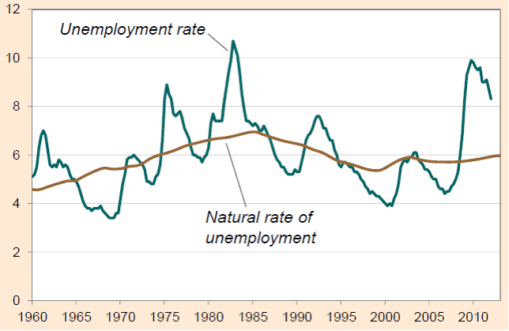
Unemployment in the U.S. 1960–2012

Slide 25
What does the unemployment rate really measure?
It is difficult to distinguish between a person who is unemployed and a person who is not in the labor force.
Discouraged workers, people who want to work but have given up looking for jobs after an unsuccessful search,
These people are not recorded in unemployment statistics.

Slide 26
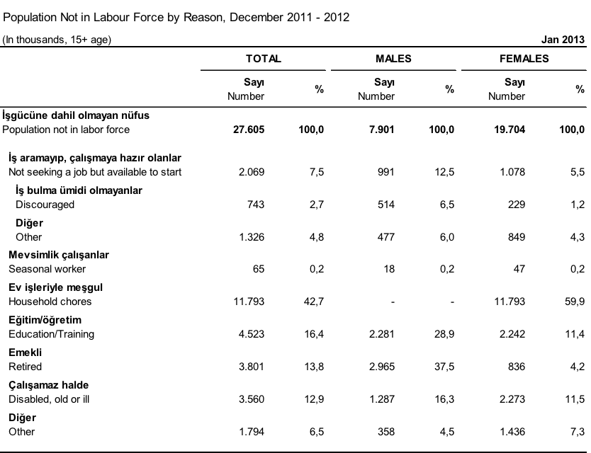

Slide 27
NOT INCLUDED IN THE LABOR: Non-institutional population of working age who are unemployed or not in employment.
Those not included in the labor force are divided into the following groups
1. Those who are not looking for a job but are ready to work: Persons who are not looking for a job for various reasons, but who state that they are ready to start work within 2 weeks. It is covered under two subheadings:
a.Those who have no hope of finding a job: These are the people who have not been able to find a job although they have been looking for a job before, or who do not look for a job because they do not believe that they can find a job suitable for their qualifications, but who state that they are ready to start a job.
b.Other: Persons who do not seek a job for reasons such as seasonal work, being a housewife, being a student, having an income, retirement or being unable to work, but stating that they are ready to start work..

Slide 28
2. Seasonal employees: Persons who are not looking for a job due to their seasonal work and are not ready to start work.
3. Busy with housework: These are people who are not looking for a job and are not ready to start work because they are busy with housework in their own home.
4. Education/Training: People who are not looking for a job and not ready to start a job due to attending a learning institution.
5. Retired: Persons who are not looking for a job and are not ready to start a job because they have retired from a social security institution.
6. Unable to work: Persons who are not looking for a job and are not ready to start work due to physical disability, illness or old age.
7. Other: Persons who are not looking for a job and are not ready to start work due to family and personal reasons and other reasons.

Slide 29
Unemployment and socio-economic groups
The United Kingdom

Slide 30

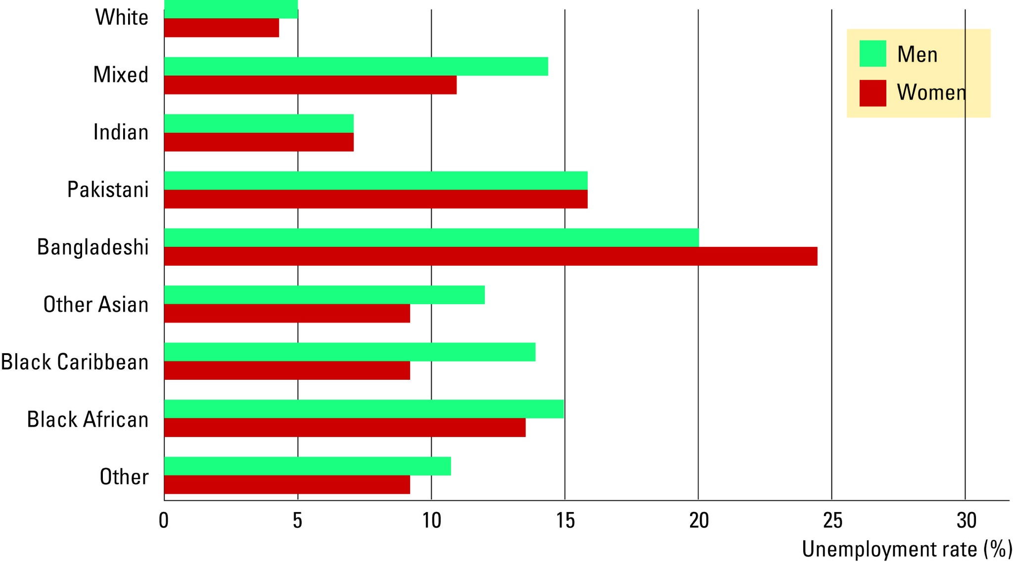
The Labour Market Experience of Different Groups
Copyright©2010 South-Western

Slide 31
How long are the unemployed without work?
In US and UK
Most spells of unemployment are short.
But
most unemployment observed at any given time is long-term.
most of the economy’s unemployment problem comes from few workers who are jobless for long periods of time.

Slide 32
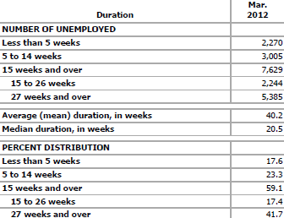
The U.S., Bureau of Labor Statistics March 2013

Slide 33
In the first few weeks after losing their jobs, about 3 in 10 people find work.
After about a year of being out of work, the chances of finding a job fall to 1 in 10 per month.
People with the best job prospects find new jobs quickly.
But those who come from industries that are downsizing or who have outdated skills can wind up unemployed for many months or even years.

Slide 34
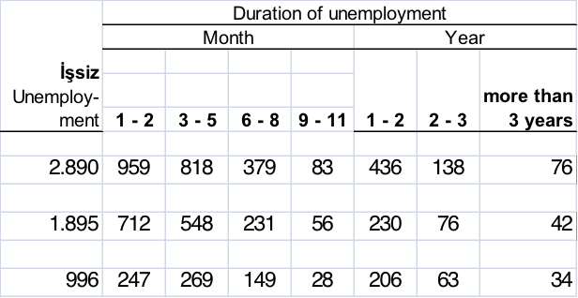
Turkey: DURATION OF UNEMPLOYMENT BY YEARS AND SEX (Thousand person, 15+ age)
unemployed
F M Total

Slide 35
The human cost of unemployment
Real people: The effect of unemployment

Slide 36
http://www.huffingtonpost.com/robert-leahy-phd/unemployment-health_b_2616430.html
Research suggests that being unemployed doubles a person's chance of a major depressive episode
Unemployment is also highly associated with domestic violence and alcohol abuse.
Men with children view unemployment as more a defeat than women with children, perhaps because women might be more likely to view a lack of a job as a chance to spend more time with family.

Slide 37
Physical health may also suffer: new medical conditions such as hypertension and diabetes may follow the loss of a job.
Strains on intimate relationships might result from being unemployed, since frustration between partners can result from financial worries.
Feeling uncomfortable and embarrassed about their situations, some unemployed people isolate themselves socially and don't find enjoyment in the activities they once did. They may feel hopeless, confused or overwhelmed.

Slide 38
A few remarks on labor force participation rates in Turkey

Slide 39
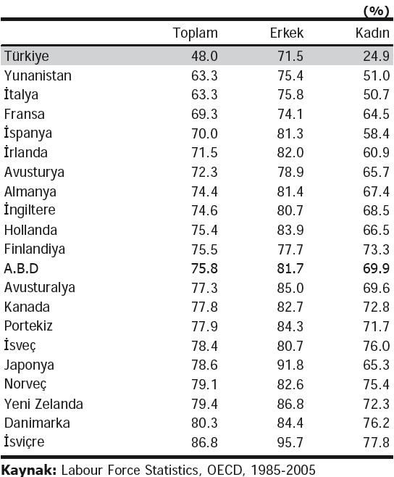
Labor force participation, selected countries, 2005

Slide 40
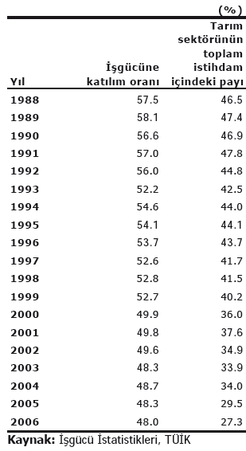
Labor force participation, Turkey, 1988-2006
Year LFPR Agriculture

Slide 41
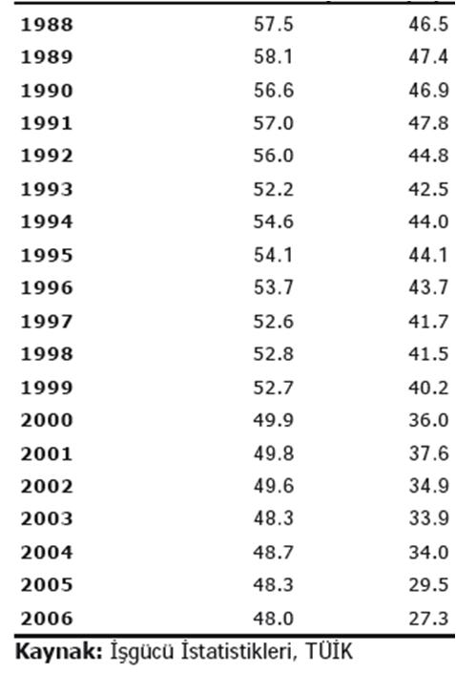
Labor force participation, Turkey, 1988-2006
Year LFPR Agriculture

Slide 42
A little bit of theory

Slide 43
Why Are There Always Some People Unemployed?
In an ideal labor market, wages will adjust to balance the supply and demand, so that all workers who are willing to work at the equilibrium wage rate will find employment.

Slide 44
Cyclical Unemployment vs. the Natural Rate
All countries always experience some unemployment.
The unemployment rate fluctuates from year to year.
The natural rate of unemployment is
the normal rate of unemployment around which the actual unemployment rate fluctuates
The cyclical unemployment is
the deviation of unemployment from its natural rate
Because of business cycles, the economy’s growth.
Notes:
Unemployment is a serious and complicated problem with a variety of causes. To most effectively address such a problem, we need to break it down and look at each cause separately.
We begin by noting that the causes of short-run fluctuations in unemployment are different than the causes of the long-run average unemployment rate, called the “natural rate of unemployment.”
The next slide shows data on both, for the U.S. economy, for the period 1960-2004.

Slide 45
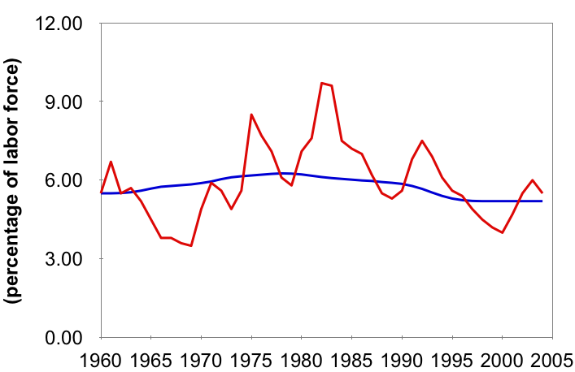
U.S. Unemployment Since 1960
Unemployment rate
Natural rate of unemployment
Notes:
Cyclical unemployment is the gap between the red and blue lines. When the economy is in recession – the bad part of the business cycle - the actual unemployment rate is higher than the natural rate, and cyclical unemployment is positive. When the economy is in the good part of its business cycle, unemployment is below normal and cyclical unemployment is negative.
Source: same as textbook.
The unemployment rate comes from the Department of Labor and is available at www.bls.gov.
The natural rate of unemployment series is prepared by the Congressional Budget Office. I have not been able to find it at the CBO website (www.cbo.gov). It is available (with tons of other data) at www.economagic.com; paid subscribers can download it in Excel format; others can view it at their site for free.
If you find a free source for the CBO’s natural rate series, please let me know! Thanks.

Slide 46
Explaining the Natural Rate: An Overview
Even when the economy is doing well, there is always some unemployment, including:
frictional unemployment
occurs when workers spend time searching for the jobs that best suit their skills and tastes
short-term for most workers
structural unemployment
occurs when there are fewer jobs than workers
usually longer-term
Minimum wage laws, trade unions
Notes:
In later chapters, we will study short-run economic fluctuations and learn more about the causes and possible cures of cyclical unemployment. For the rest of this chapter, our job is understanding the various causes of the natural rate of unemployment.
* * WARNING: If you are teaching with Mankiw for the first time, please note that his definition of structural unemployment may be different than the definition you’ve seen in other textbooks.
Other books commonly define structural unemployment as arising from a mismatch between the skills or locations of workers and the skill requirements or locations of jobs. Such textbooks assert that such unemployment results from sectoral shifts.
Mankiw’s position is as follows: If all wages were flexible, then they would adjust after structural changes so that all workers with any given skill set in any given location would be employed. The cause of “structural unemployment” therefore cannot be changes in the structure of demand and production; the cause must be wages that fail to adjust following these changes.

